Slide 1
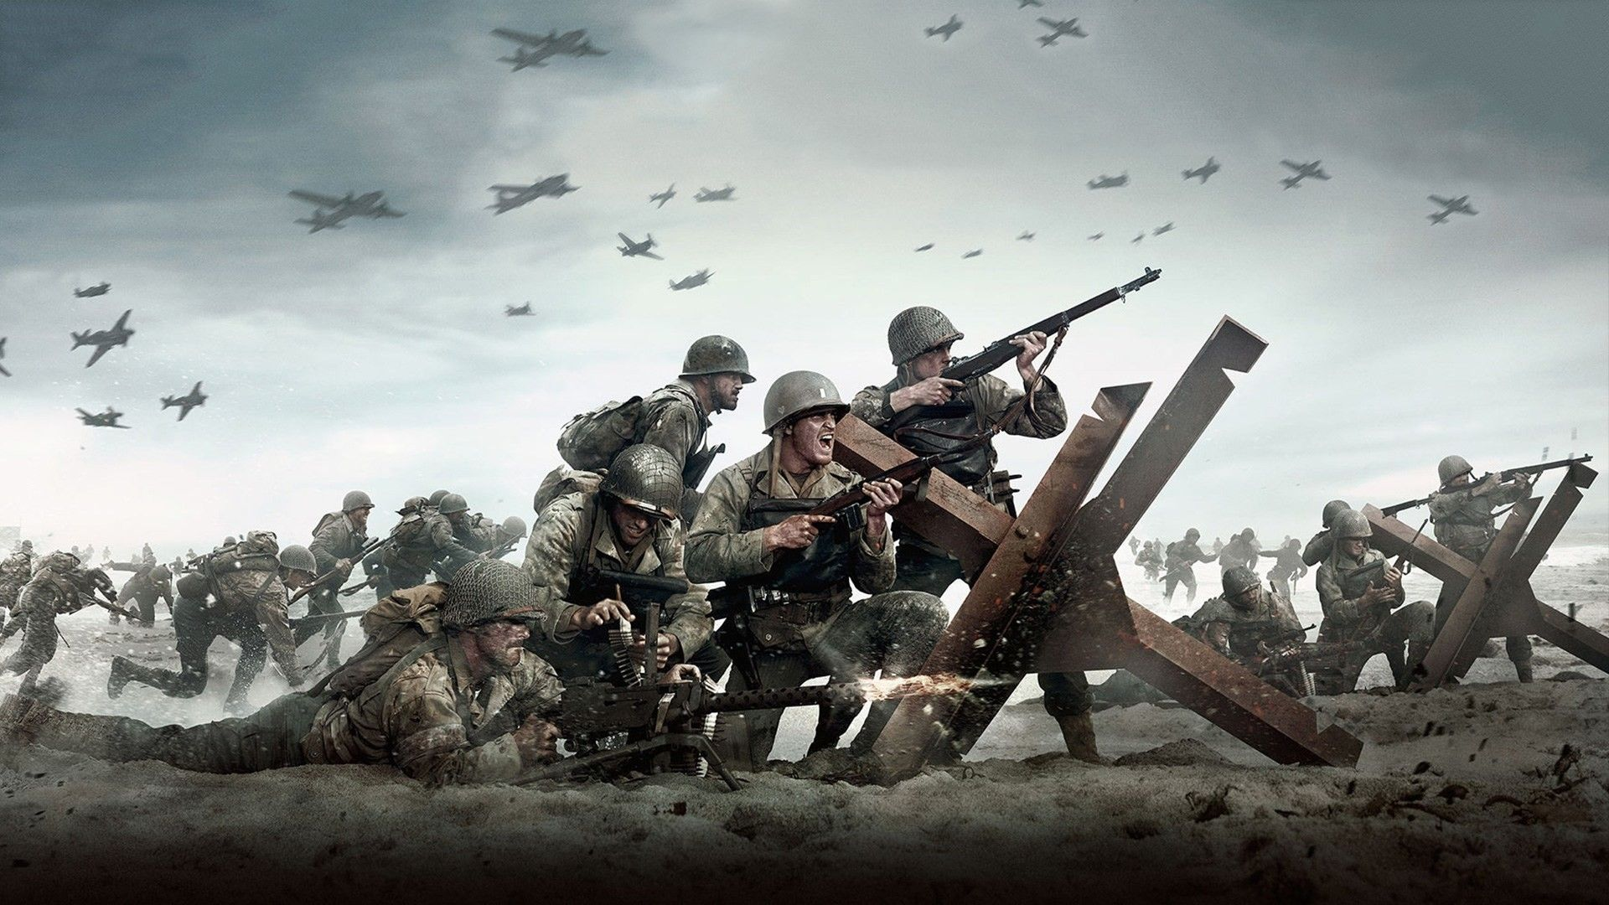
World Wars Its
Cause And Effects

Slide 2

World war I 1914 – 1918
World War II 1939 - 1945

Slide 3
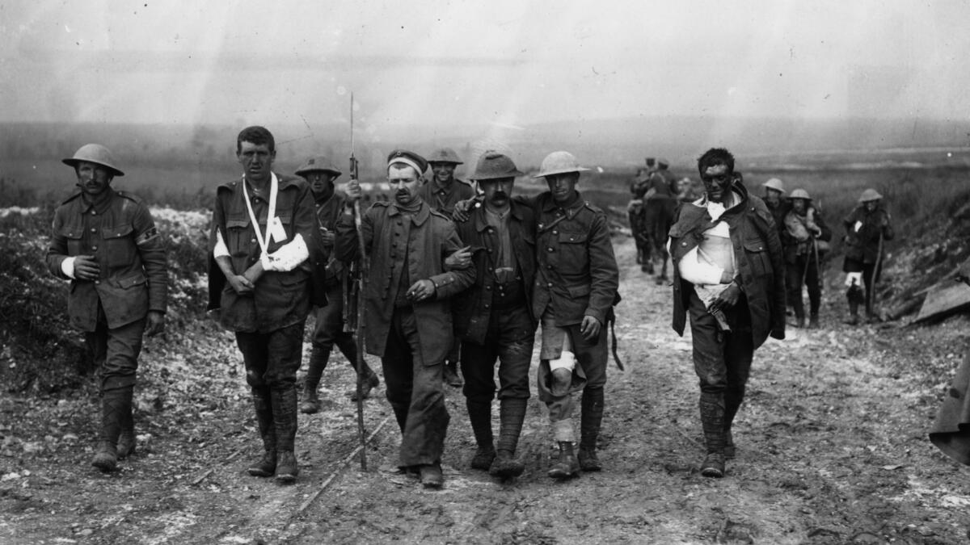

CAUSES OF WORLD WAR I
Militarism
Imperialism
Alliances
Nationalism

Slide 4
WORLD WAR I
Allies
Central Powers
British Empire
France
Russian Empire
Germany
Austria-Hungary
Italy
Turkey

Slide 5
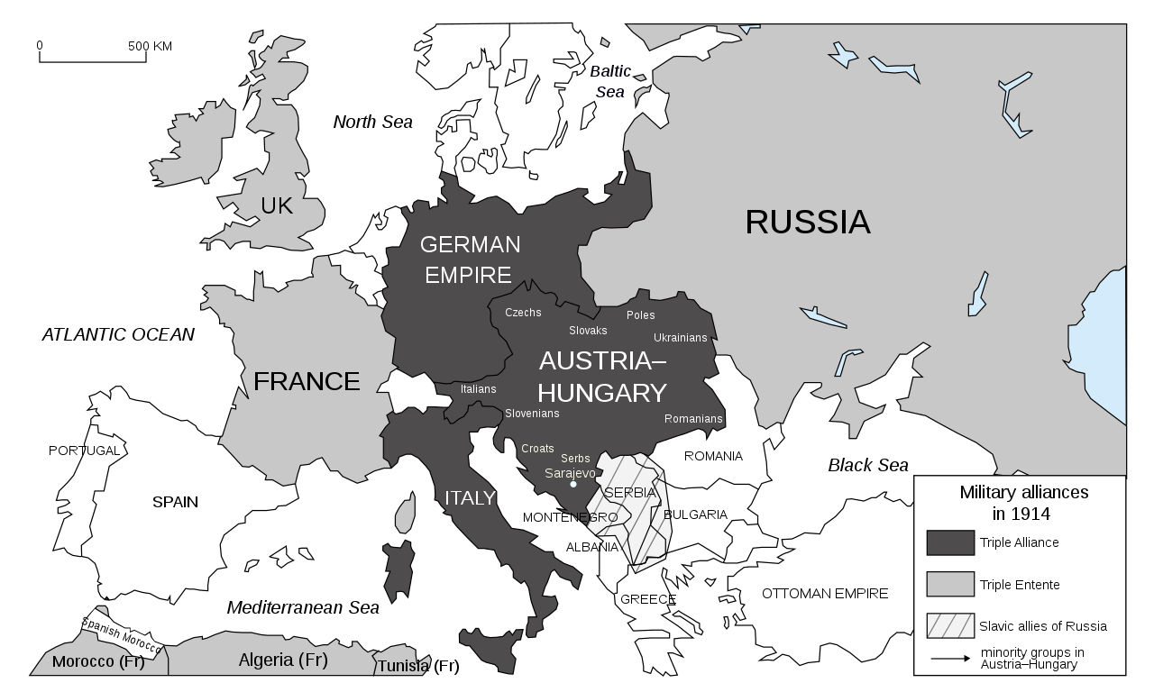
Alliances

Slide 6


Slide 7
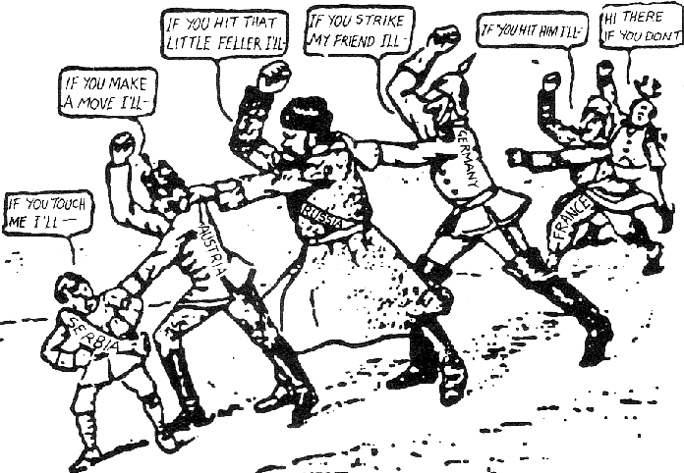

Slide 8

The assassination of Archduke Franz Ferdinand of Austria-Hungary. June 28,1914

Slide 9
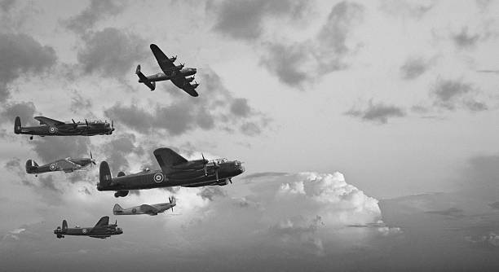
Effects Of World War 1

Slide 10
Over 16 million were killed and 20 million were injured, making one of the deadliest conflicts of human history.
Political Changes
Economic Changes
Social Changes
Technological Changes

Slide 11
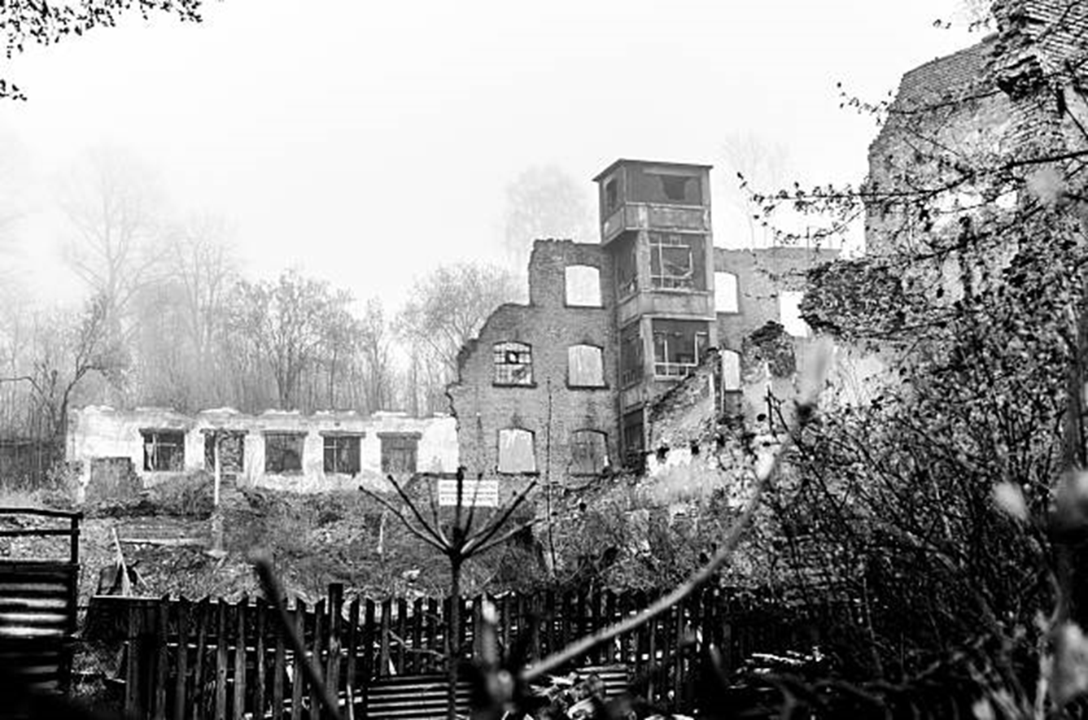

Slide 12
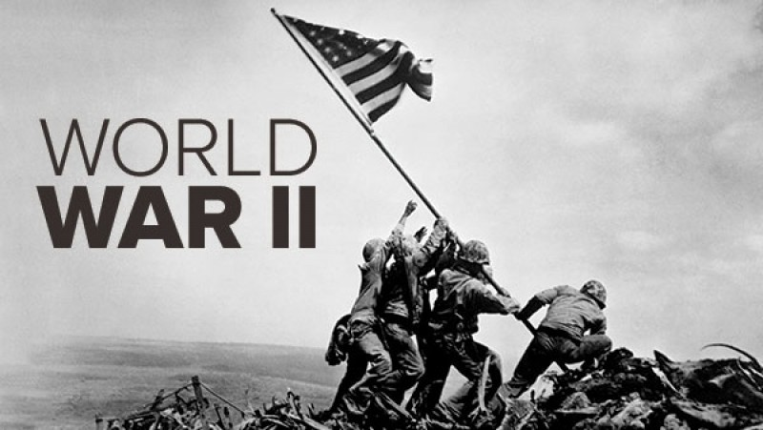
World War II

Slide 13
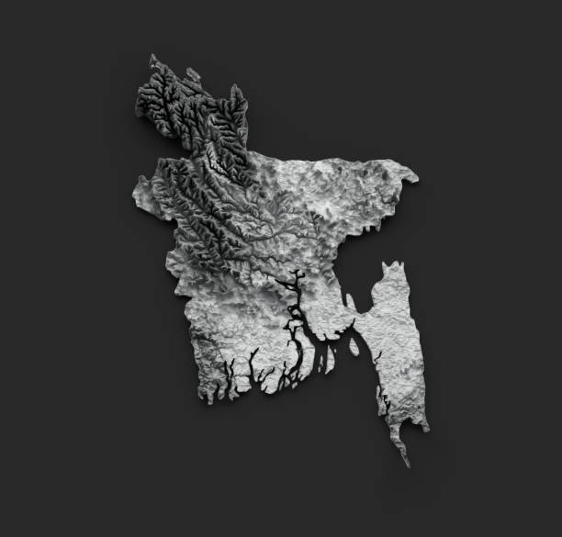
Causes of World War II
The treaty of Versailles
The rise of Fascism and Nazism
The failure of appeasement
The invasion of Poland: September 1,1939

Slide 14
World War II
Allies Powers
Axis Powers
France
Britian
U.S
Soviet Union
Germany
Italy
Japan

Slide 15
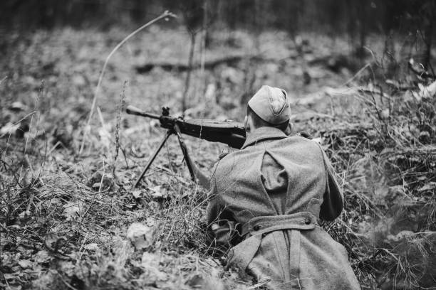

Slide 16

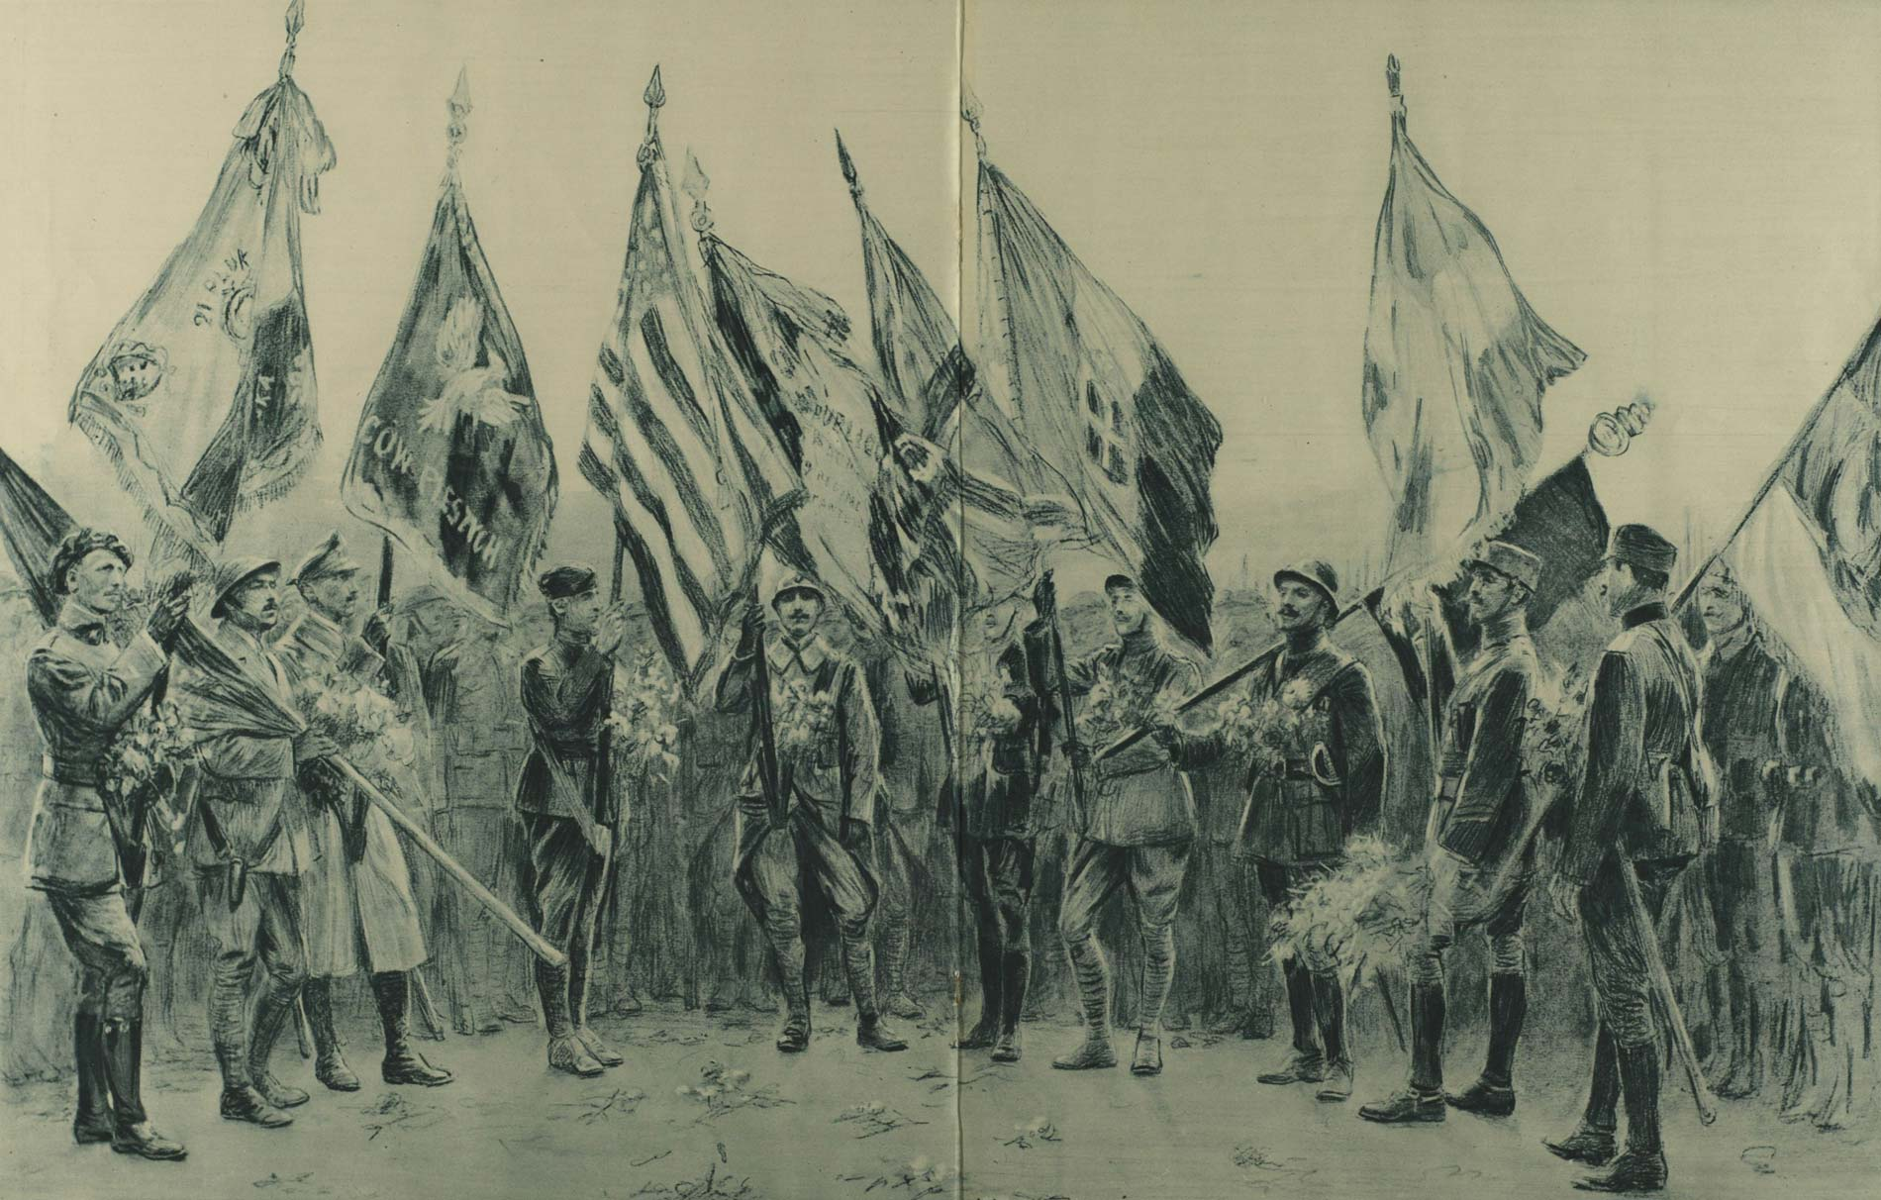

Slide 17
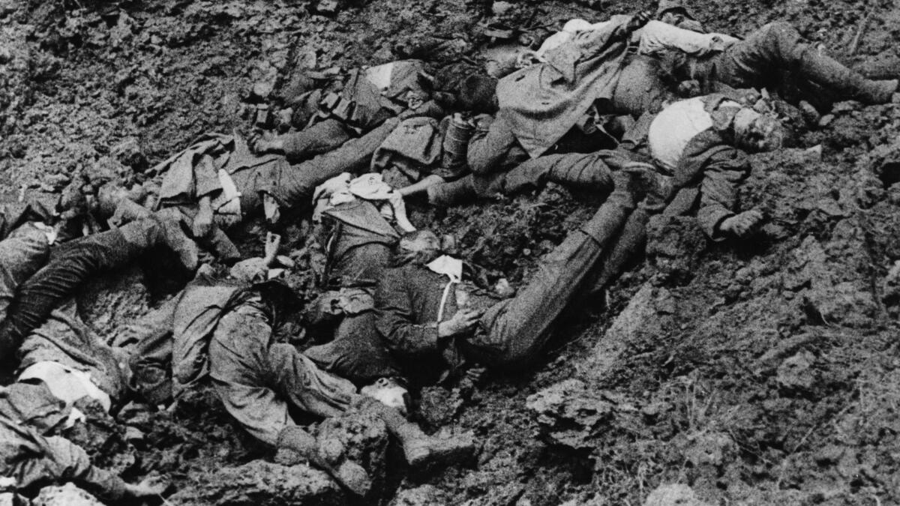
Destruction

Slide 18
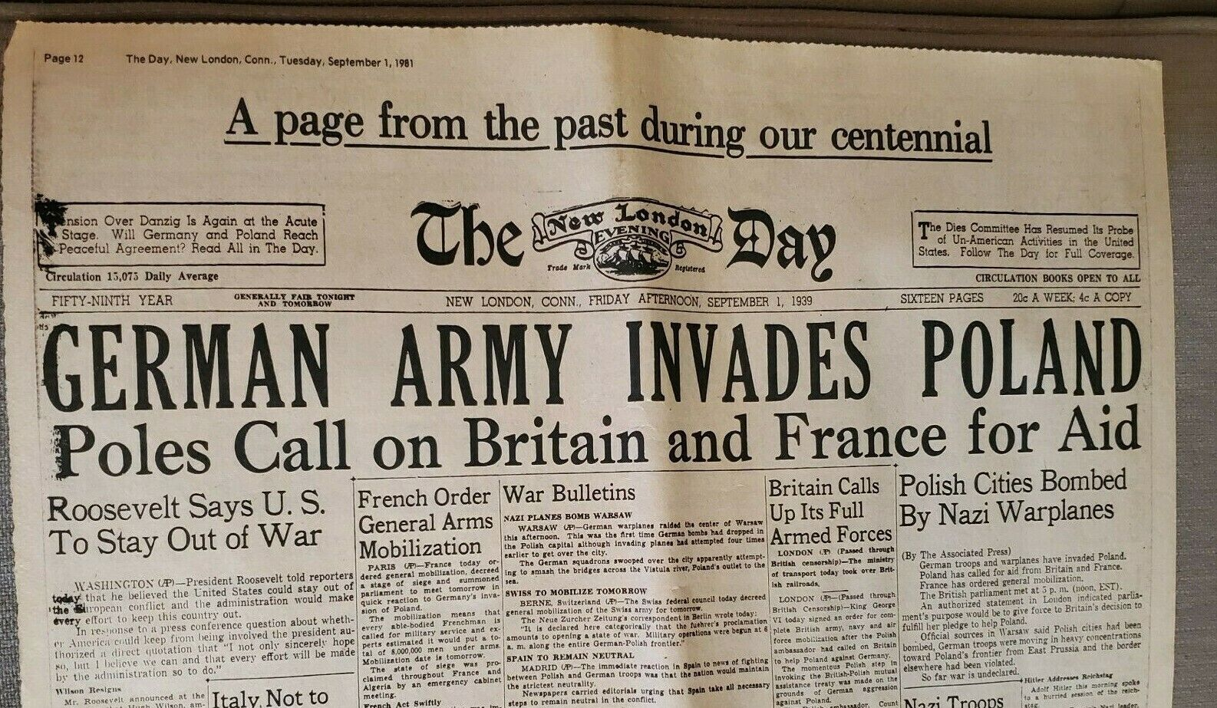

Slide 19
Effects of World War II

Slide 20
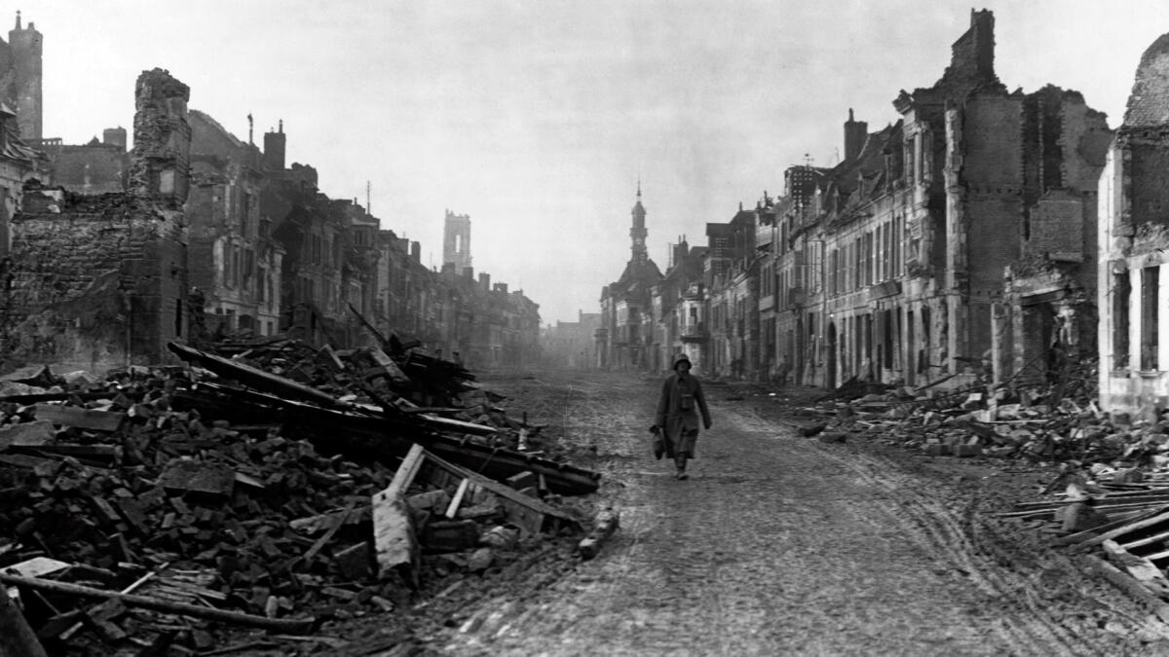

Slide 21
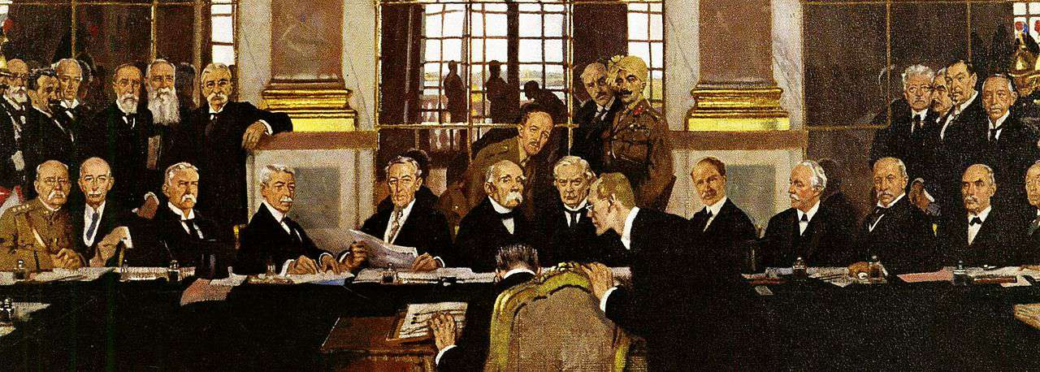
Over 60 Million people were killed, making it the deadliest conflict in the human history.
The war lead to the defeat of Axis powers(Germany, Italy, and Japan).
Emergence of the United states
Soviet Union powers

Slide 22

Political Changes

Slide 23
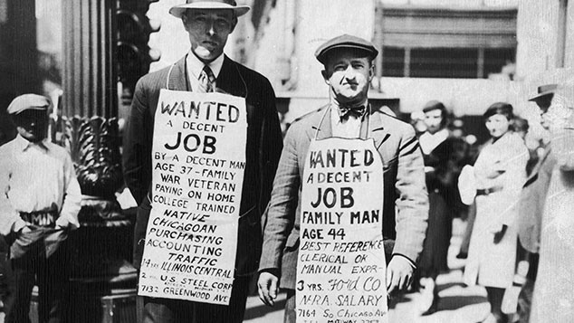
Economic Crisis

Slide 24
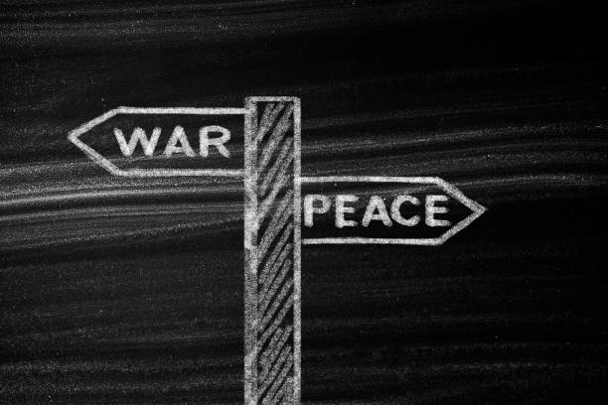
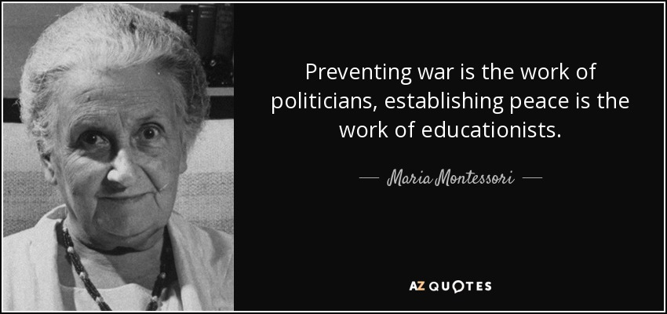
Conclusion

